Slide 1
Multiprocessor and
Distributed Systems
CS-3013 & CS-502
Operating Systems

Slide 2
Overview – Interrelated topics
Multiprocessor Systems
Distributed Systems
  Distributed File Systems

Slide 3
Distributed Systems
Nearly all systems today are distributed in some way, e.g.:
  they use email
  they access files over a network
  they access printers over a network
  they are backed up over a network
  they share other physical or logical resources
  they cooperate with other people on other machines
  they receive video, audio, etc.

Slide 4
Distributed Systems – Why?
Distributed systems are now a requirement:
  Economics – small computers are very cost effective
Resource sharing
  sharing and printing files at remote sites
  processing information in a distributed database
  using remote specialized hardware devices
Many applications are by their nature distributed
  bank teller machines, airline reservations, ticket purchasing
Computation speedup – To solve the largest or most data intensive problems , we use many cooperating small machines (parallel programming)
Reliability

Slide 5
What is a Distributed System?
There are several levels of distribution.
Earliest systems used simple explicit network programs:
  FTP: file transfer program
  Telnet (rlogin): remote login program
  mail
  remote job entry (or rsh): run jobs remotely
Each system was a completely autonomous independent system, connected to others on the network

Slide 6
Loosely Coupled Systems
Most distributed systems are “loosely-coupled
Each CPU runs an independent autonomous OS
Hosts communicate through message passing.
Computers/systems don’t really trust each other
Some resources are shared, but most are not
The system may look differently from different hosts
Typically, communication times are long
    Relative to processing times

Slide 7
Closely-Coupled Systems
Distributed system becomes more “closely coupled” as it:
  appears more uniform in nature
  runs a “single” operating system (cooperating across all machines)
  has a single security domain
  shares all logical resources (e.g., files)
  shares all physical resources (CPUs, memory, disks, printers, etc.)
In the limit, a closely-coupled distributed system: –
  Multicomputer
    Multiple computers – CPU and memory and network interface (NIC)
    High performance interconnect
  Looks a lot like a single system
    E.g., Beowulf clusters

Slide 8
Tightly Coupled Systems
Tightly coupled systems usually are multiprocessor systems
  Have a single address space
  Usually has a single bus or backplane to which all processors and memories are connected
  Low communication latency
  Shared memory for processor communication
  Shared I/O device access
Example:
  Multiprocessor Windows PC

Slide 9
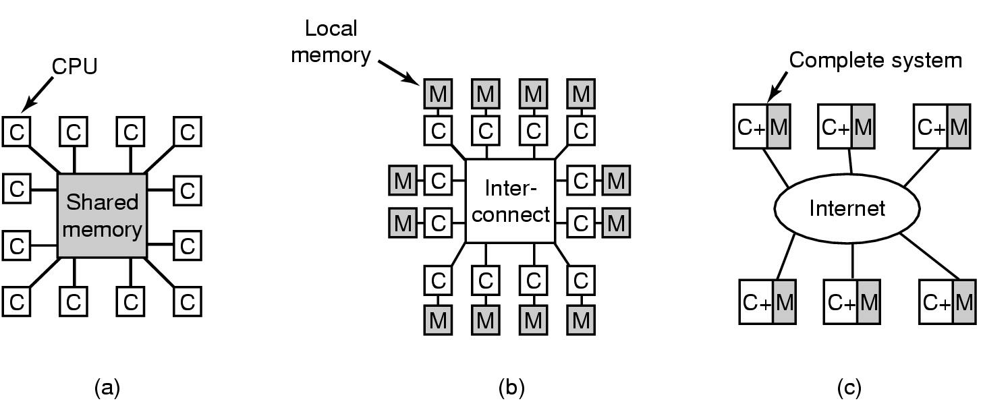
Distributed Systems – a Spectrum
Tightly coupled
Multiprocessor
Latency – nanoseconds
Closely coupled
Multicomputer
Latency – microseconds
Loosely coupled
Latency – milliseconds

Slide 10
Distributed Systems –
Software Overview (1)
Network Operating System
  Users are aware of multiplicity of machines.
  Access to resources of various machines is done explicitly by:
    Remote logging into the appropriate remote machine.
    Transferring data from remote machines to local machines, via the File Transfer Protocol (FTP) mechanism.

Slide 11
Distributed Systems –
Software Overview (2)
Distributed Operating System
  Users not aware of multiplicity of machines. Access to remote resources similar to access to local resources.
  Data Migration – transfer data by transferring entire file, or transferring only those portions of the file necessary for the immediate task.
  Computation Migration – transfer the computation, rather than the data, across the system.
However,
  The distinction between Networked Operating Systems and Distributed Operating Systems is shrinking
    E.g., CCC cluster; Windows XP on home network

Slide 12
Multiprocessor Systems
Tightly coupled
Multiprocessor
Latency – nanoseconds
Closely coupled
Multicomputer
Latency – microseconds
Loosely coupled
Latency – milliseconds

Slide 13
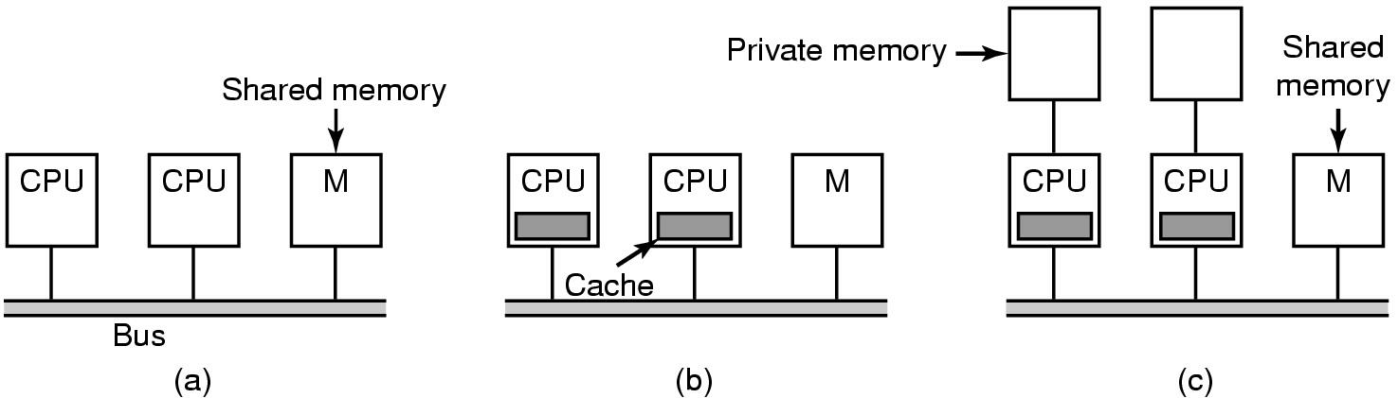
Multiprocessors (1) – Bus-based
Bus contention limits the number of CPUs
Lower bus contention
Caches need to be synced (big deal)
Compiler places data and text in private or shared memory

Slide 14
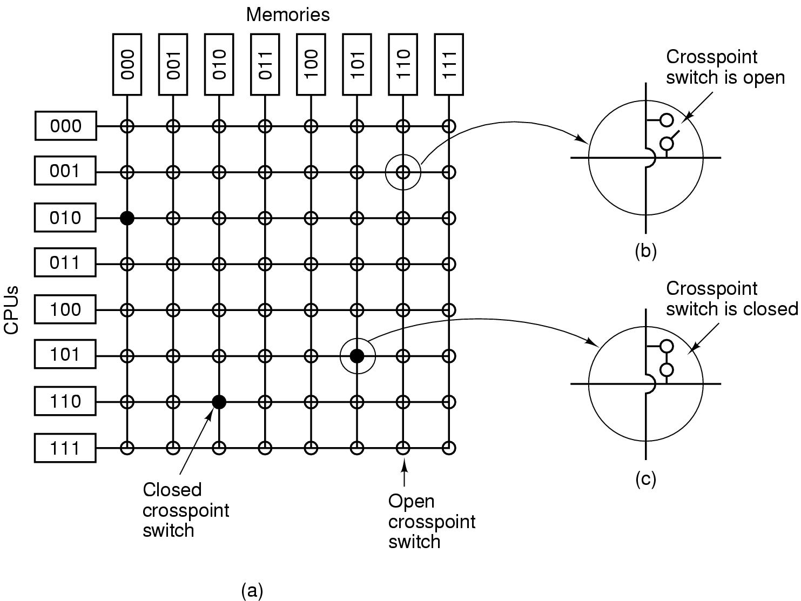
Multiprocessors (2) - Crossbar
Can support a large number of CPUs -
Non-blocking network
Cost/performance effective up to about 100 CPU – growing as n²

Slide 15
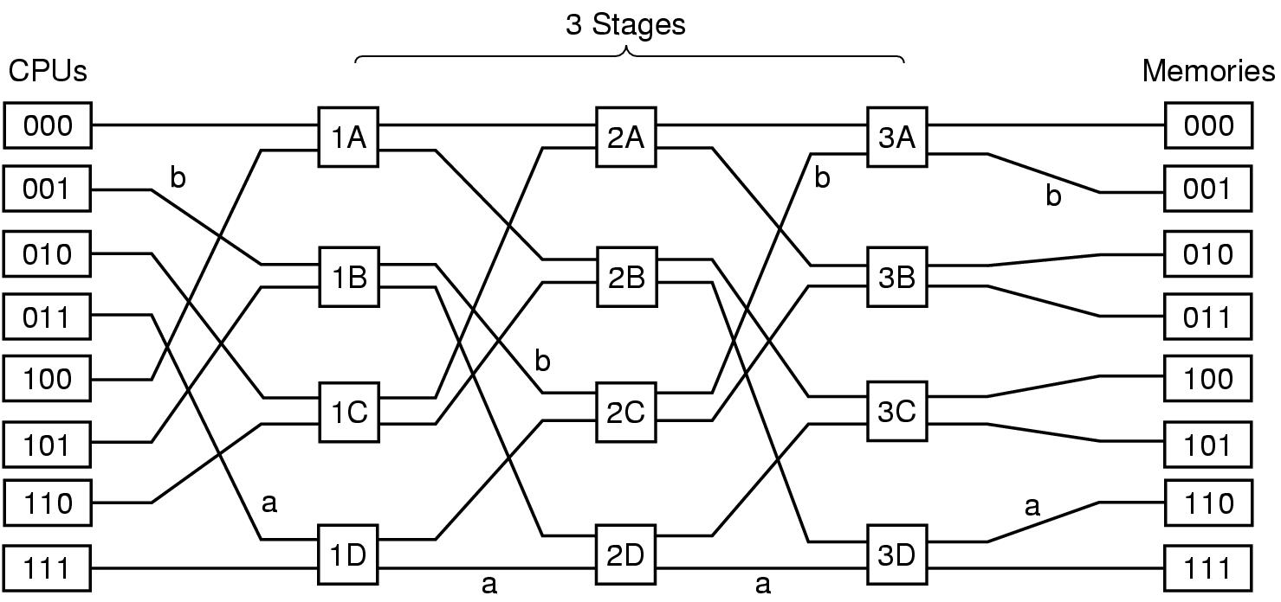
Multistage Switching Networks
Omega Network – blocking
  Lower cost, longer latency
  For N CPUs and N memories – log₂ n stages of n/2 switches

Slide 16
Type of Multiprocessors –
UMA vs. NUMA
UMA (Uniform Memory Access)
  Shared Memory Multiprocessor
  Familiar programming model
  Number of CPUs are limited
  Completely symmetrical
NUMA (Non-Uniform Memory Access)
  Single address space visible to all CPUs
  Access to remote memory via commands
    LOAD & STORE
    remote memory access slower than to local

Slide 17
Caching vs. Non-caching
No caching
  Remote access time not hidden
  Slows down a fast processor
    May impact programming model
Caching
  Hide remote memory access times
  Complex cache management hardware
  Some data must be marked as non-cachable
    Visible to programming model

Slide 18
Multiprocessor Systems
Tightly coupled
Multiprocessor
Latency – nanoseconds
Closely coupled
Multicomputer
Latency – microseconds
Loosely coupled
Latency – milliseconds

Slide 19
Multiprocessor OS – Private OS
Each processor has a copy of the OS
  Looks and generally acts like N independent computers
  May share OS code
  OS Data is separate
  I/O devices and some memory shared
    Synchronization issues
  While simple, benefits are limited

Slide 20
Multiprocessor OS –
Master-Slave
One CPU (master) runs the OS and applies most policies
Other CPUs
  run applications
  Minimal OS to acquire and terminate processes
Relatively simple OS
Master processor can become a bottleneck for a large number of slave processors

Slide 21
Symmetric Multi-Processor (SMP)
Any processor can execute the OS and applications
Synchronization within the OS is the issue
  Lock the whole OS – poor utilization – long queues waiting to use OS
  OS critical regions – much preferred
    Identify independent OS critical regions that be executed independently – protect with mutex
    Identify independent critical OS tables – protect access with MUTEX
    Design OS code to avoid deadlocks
      The art of the OS designer
      Maintenance requires great care

Slide 22
Multiprocessor OS – SMP (continued)
Multiprocessor Synchronization
  Need special instructions – test-and-set
  Spinlocks are common
    Can context switch if time in critical region is greater than context switch time
    OS designer must understand the performance of OS critical regions
Context switch time could be onerous
  Data cached on one processor needs to be re-cached on another

Slide 23
Multiprocessor Scheduling
When processes are independent (e.g., timesharing)
  Allocate CPU to highest priority process
  Tweaks
    For a process with a spinlock, let it run until it releases the lock
    To reduce TLB and memory cache flushes, try to run a process on the same CPU each time it runs
For groups of related processes
  Attempt to simultaneously allocate CPUs to all related processes (space sharing)
  Run all threads to termination or block
  Gang schedule – apply a scheduling policy to related processes together

Slide 24
Multicomputer Systems
Tightly coupled
Multiprocessor
Latency – nanoseconds
Closely coupled
Multicomputer
Latency – microseconds
Loosely coupled
Latency – milliseconds

Slide 25
Multicomputers
Multiprocessor size is limited
Multicomputers – closely coupled processors that do not physically share memory
  Cluster computers
  Networks or clusters of computers (NOWs or COWs)
  Can grow to a very large number of processors
Consist of
  Processing nodes – CPU, memory and network interface (NIC)
  I/O nodes – device controller and NIC
  Interconnection network
    Many topologies – e.g. grid, hypercube, torus
    Can be packet switched or circuit switched

Slide 26
Inter-Process Communication (IPC) among computers
Processes on separate processors communicate by messages
  Message moved to NIC send buffer
  Message moved across the network
  Message copied into NIC receive buffer
destination host addr.
destination host addr.
source host addr.
header
application ID
msg length
msg data
checksum

Slide 27
Interprocessor Communication
Copying of messages is a major barrier to achieving high performance
  Network latency may involve copying message (hardware issue)
  Must copy message to NIC on send and from NIC on receive
  Might have additional copies between user processes and kernel (e.g., for error recovery)
  Could map NIC into user space – creates some additional usage and synchronization problems

Slide 28
Multicomputer IPC (continued)
Message Passing mechanisms
  MPI (p. 123) and PVM are two standards
  Basic operations are
    send (destinationID, &message)
    receive (senderID, &message)
  Blocking calls – process blocks until message is moved from (to) NIC buffer to (from) network {for send (receive)}
  We will look at alternative interprocess communication methods in a few minutes

Slide 29
Multicomputer Scheduling
Typically each node has its own scheduler
  With a coordinator on one node, gang scheduling is possible for some applications
Most scheduling is done when processes are created
  i.e., allocation to a processor for life of process
Load Balancing – efficiently use the system’s resources
  Many models – dependent on what is important
  Examples
    Sender-initiated - when overloaded send process to another processor
    Receiver-initiated – when underloaded ask another processor for a job

Slide 30
Multicomputer IPC
Distributed Shared Memory (DSM)
A method of allowing processes on different processors to share regions of virtual memory
Programming model (alleged to be) simpler
Implementation is essentially paging over the network
  Backing file lives in mutually accessible place
Can easily replicate read-only pages to improve performance
Writeable pages
  One copy and move as needed
  Multiple copies
    Make each frame read-only
    On write tell other processors to invalidate page to be written
    Write through

Slide 31
Remote Procedure Call

Slide 32
Remote Procedure Call (RPC)
The most common means for remote communication
Used both by operating systems and by applications
  NFS is implemented as a set of RPCs
  DCOM, CORBA, Java RMI, etc., are just RPC systems
Fundamental idea: –
  Servers export an interface of procedures/functions that can be called by client programs
    similar to library API, class definitions, etc.
Clients make local procedure/function calls
  As if directly linked with the server process
  Under the covers, procedure/function call is converted into a message exchange with remote server process

Slide 33
RPC – Issues
How to make the “remote” part of RPC invisible to the programmer?
What are semantics of parameter passing?
  E.g., pass by reference?
How to bind (locate/connect-to) servers?
How to handle heterogeneity?
  OS, language, architecture, …
How to make it go fast?

Slide 34
RPC Model
A server defines the service interface using an interface definition language (IDL)
  the IDL specifies the names, parameters, and types for all client-callable server procedures
    example: Sun’s XDR (external data representation)
A stub compiler reads the IDL declarations and produces two stub functions for each server function
  Server-side and client-side
Linking:–
  Server programmer implements the service’s functions and links with the server-side stubs
  Client programmer implements the client program and links it with client-side stubs
Operation:–
  Stubs manage all of the details of remote communication between client and server

Slide 35
RPC Stubs
A client-side stub is a function that looks to the client as if it were a callable server function
  I.e., same API as the server’s implementation of the function
A server-side stub looks like a caller to the server
  I.e., like a hunk of code invoking the server function
The client program thinks it’s invoking the server
  but it’s calling into the client-side stub
The server program thinks it’s called by the client
  but it’s really called by the server-side stub
The stubs send messages to each other to make the RPC happen transparently (almost!)

Slide 36
Marshalling Arguments
Marshalling is the packing of function parameters into a message packet
  the RPC stubs call type-specific functions to marshal or unmarshal the parameters of an RPC
    Client stub marshals the arguments into a message
    Server stub unmarshals the arguments and uses them to invoke the service function
  on return:
    the server stub marshals return values
    the client stub unmarshals return values, and returns to the client program

Slide 37
RPC Binding
Binding is the process of connecting the client to the server
  the server, when it starts up, exports its interface
    identifies itself to a network name server
    tells RPC runtime that it is alive and ready to accept calls
  the client, before issuing any calls, imports the server
    RPC runtime uses the name server to find the location of the server and establish a connection
The import and export operations are explicit in the server and client programs

Slide 38
RPC Systems
Validation of Lauer-Needham hypothesis about system organization
  Management of shared system resources or functions encapsulated in modules
  Interchangeability of function call and message passing

Slide 39
Summary
There are many forms of multiple processor systems
The system software to support them involves substantial additional complexity over single processor systems
The core OS must be carefully designed to fully utilize the multiple resources
Programming model support is essential to help application developers

